Slide 1
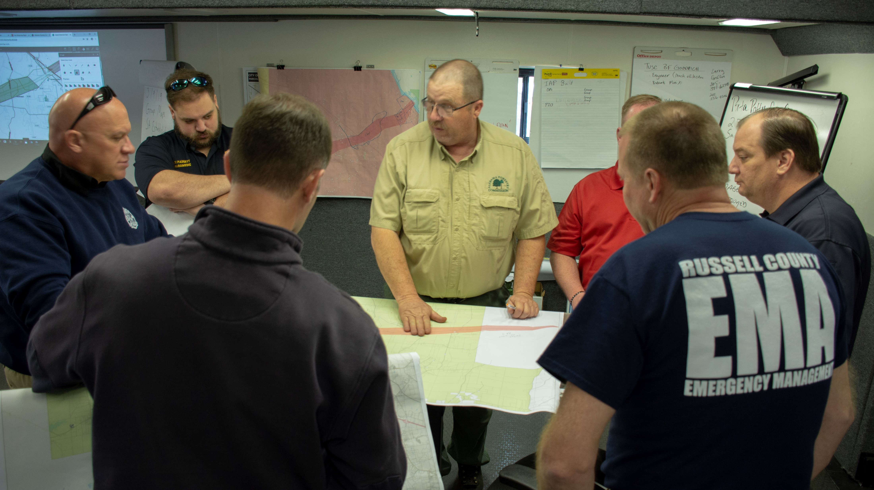
Lee County Tornadoes
Alabama Forestry Commission Incident Command
March 2019

Slide 2
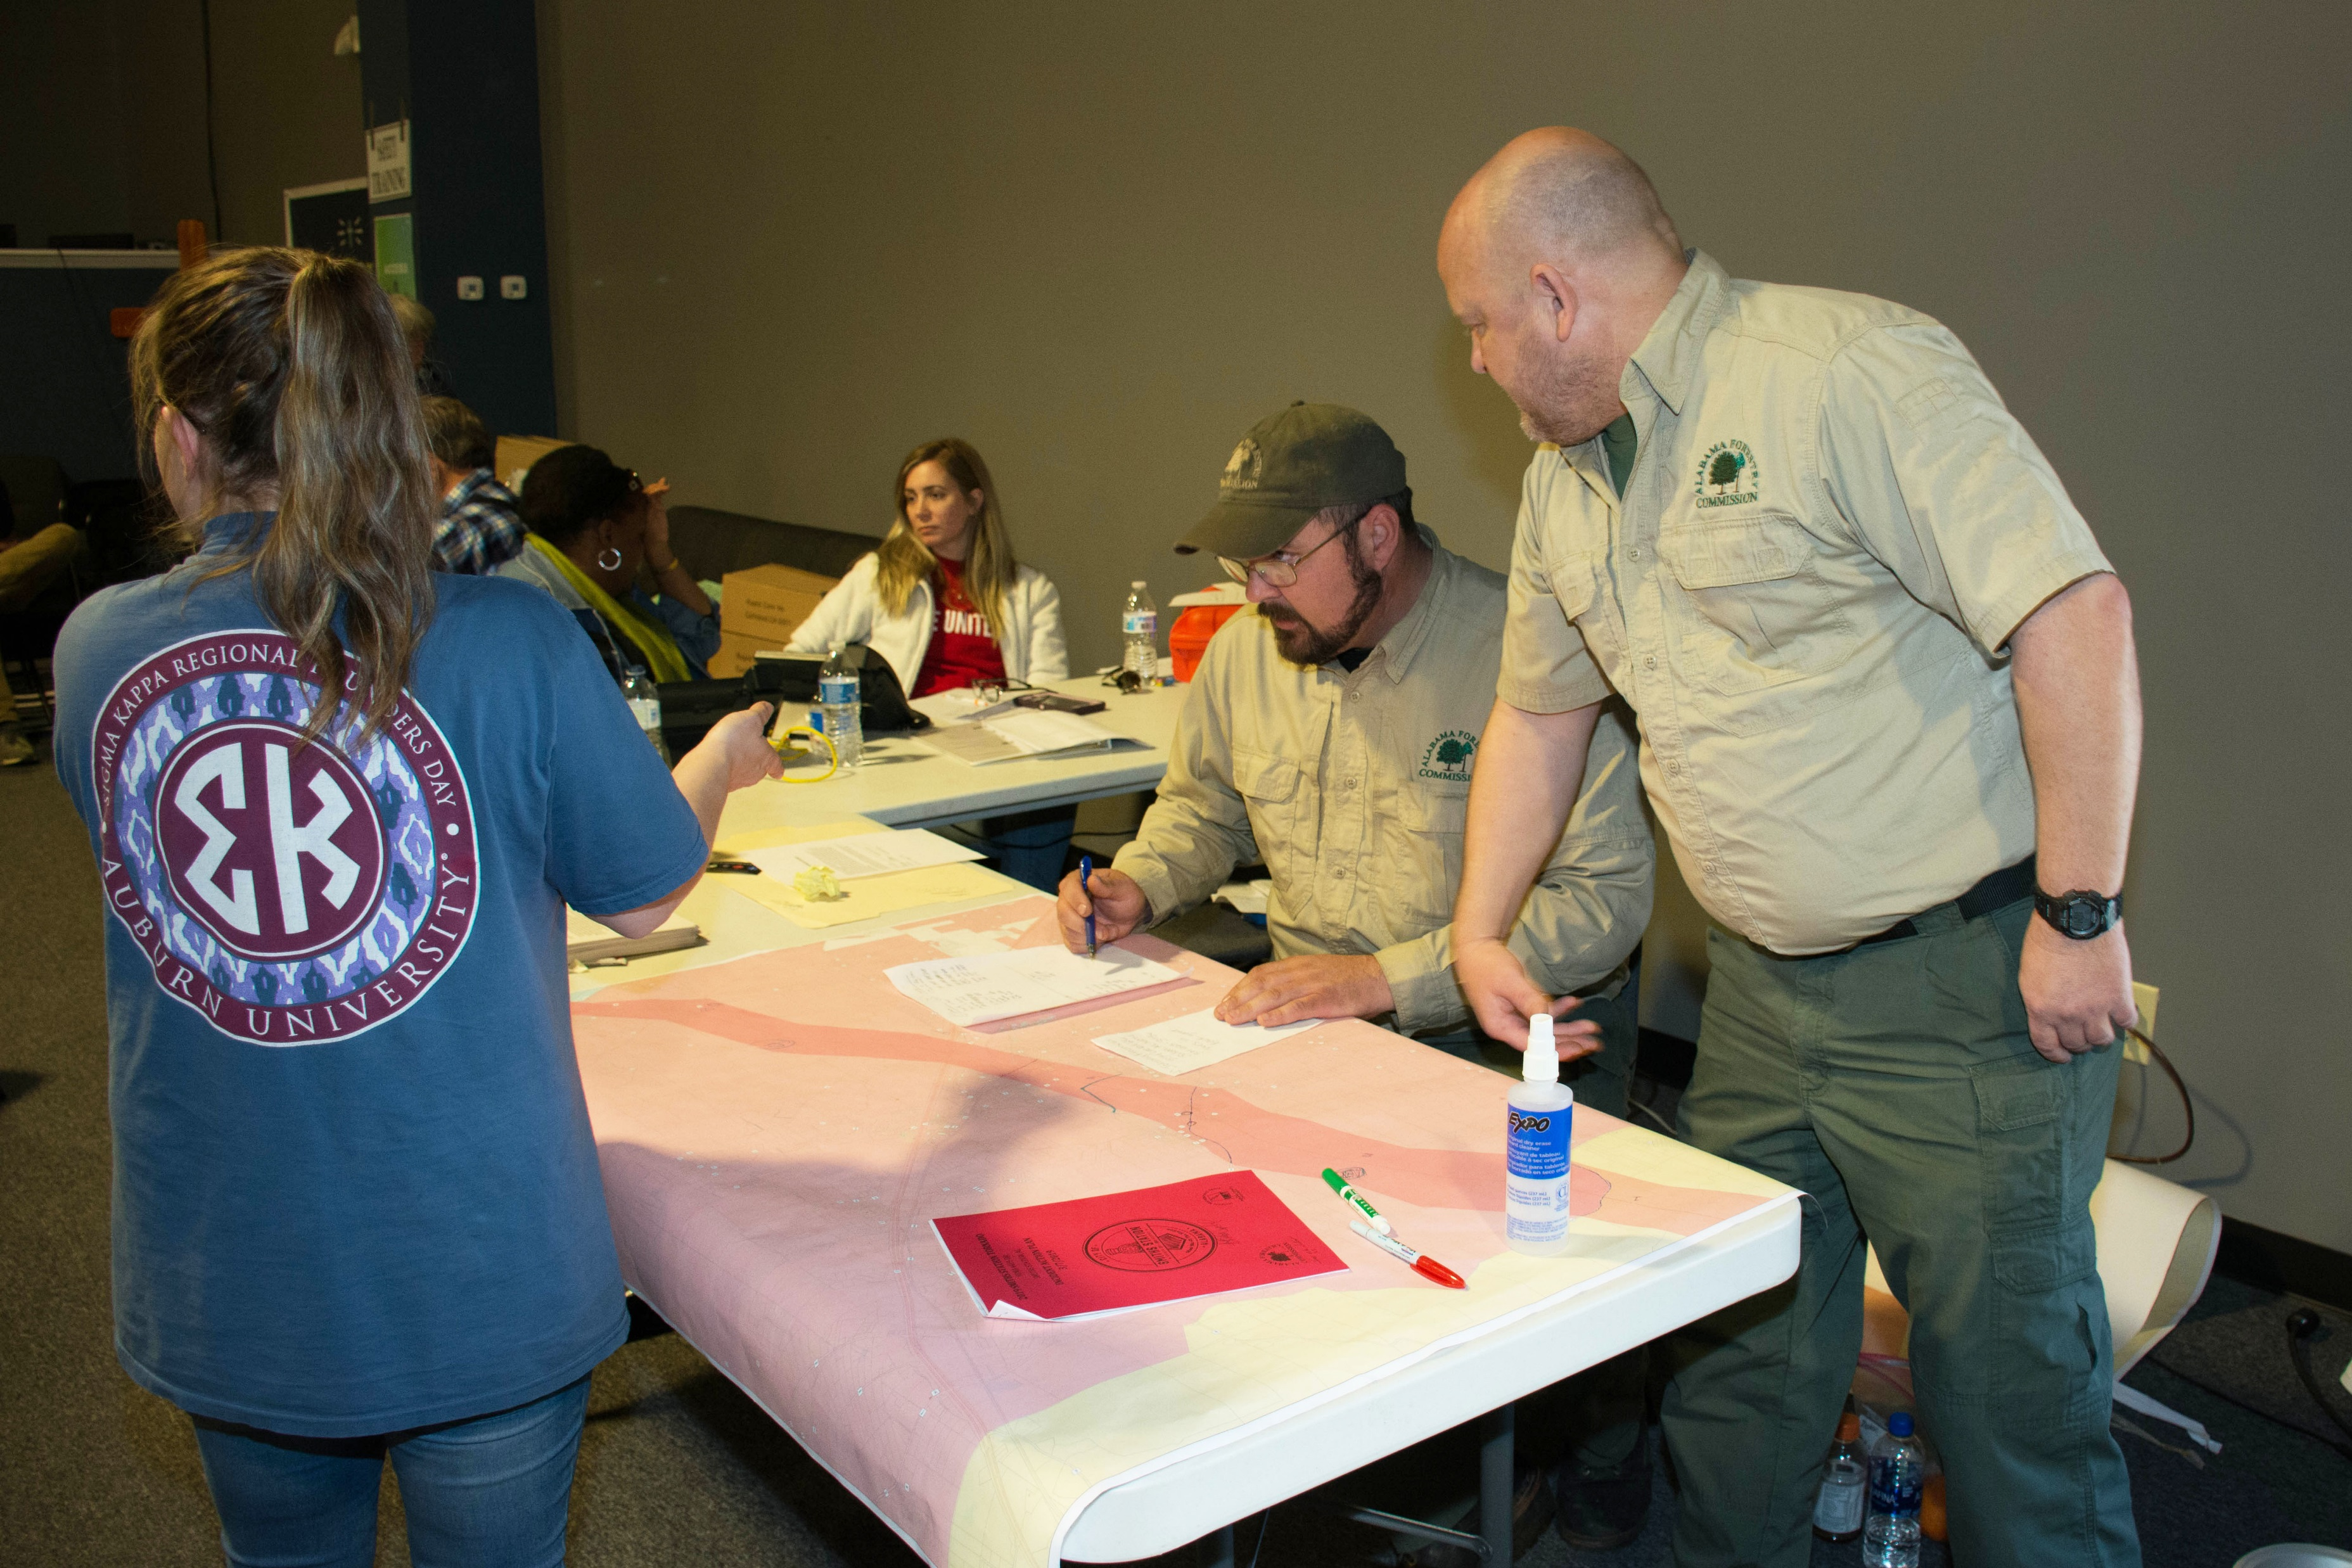
On March 5,
AEMA formally called up the AFC Type III Incident Management Team (IMT) to deploy to Smiths Station to assist in recovery efforts by establishing and managing a Volunteer Resource Center.

Slide 3
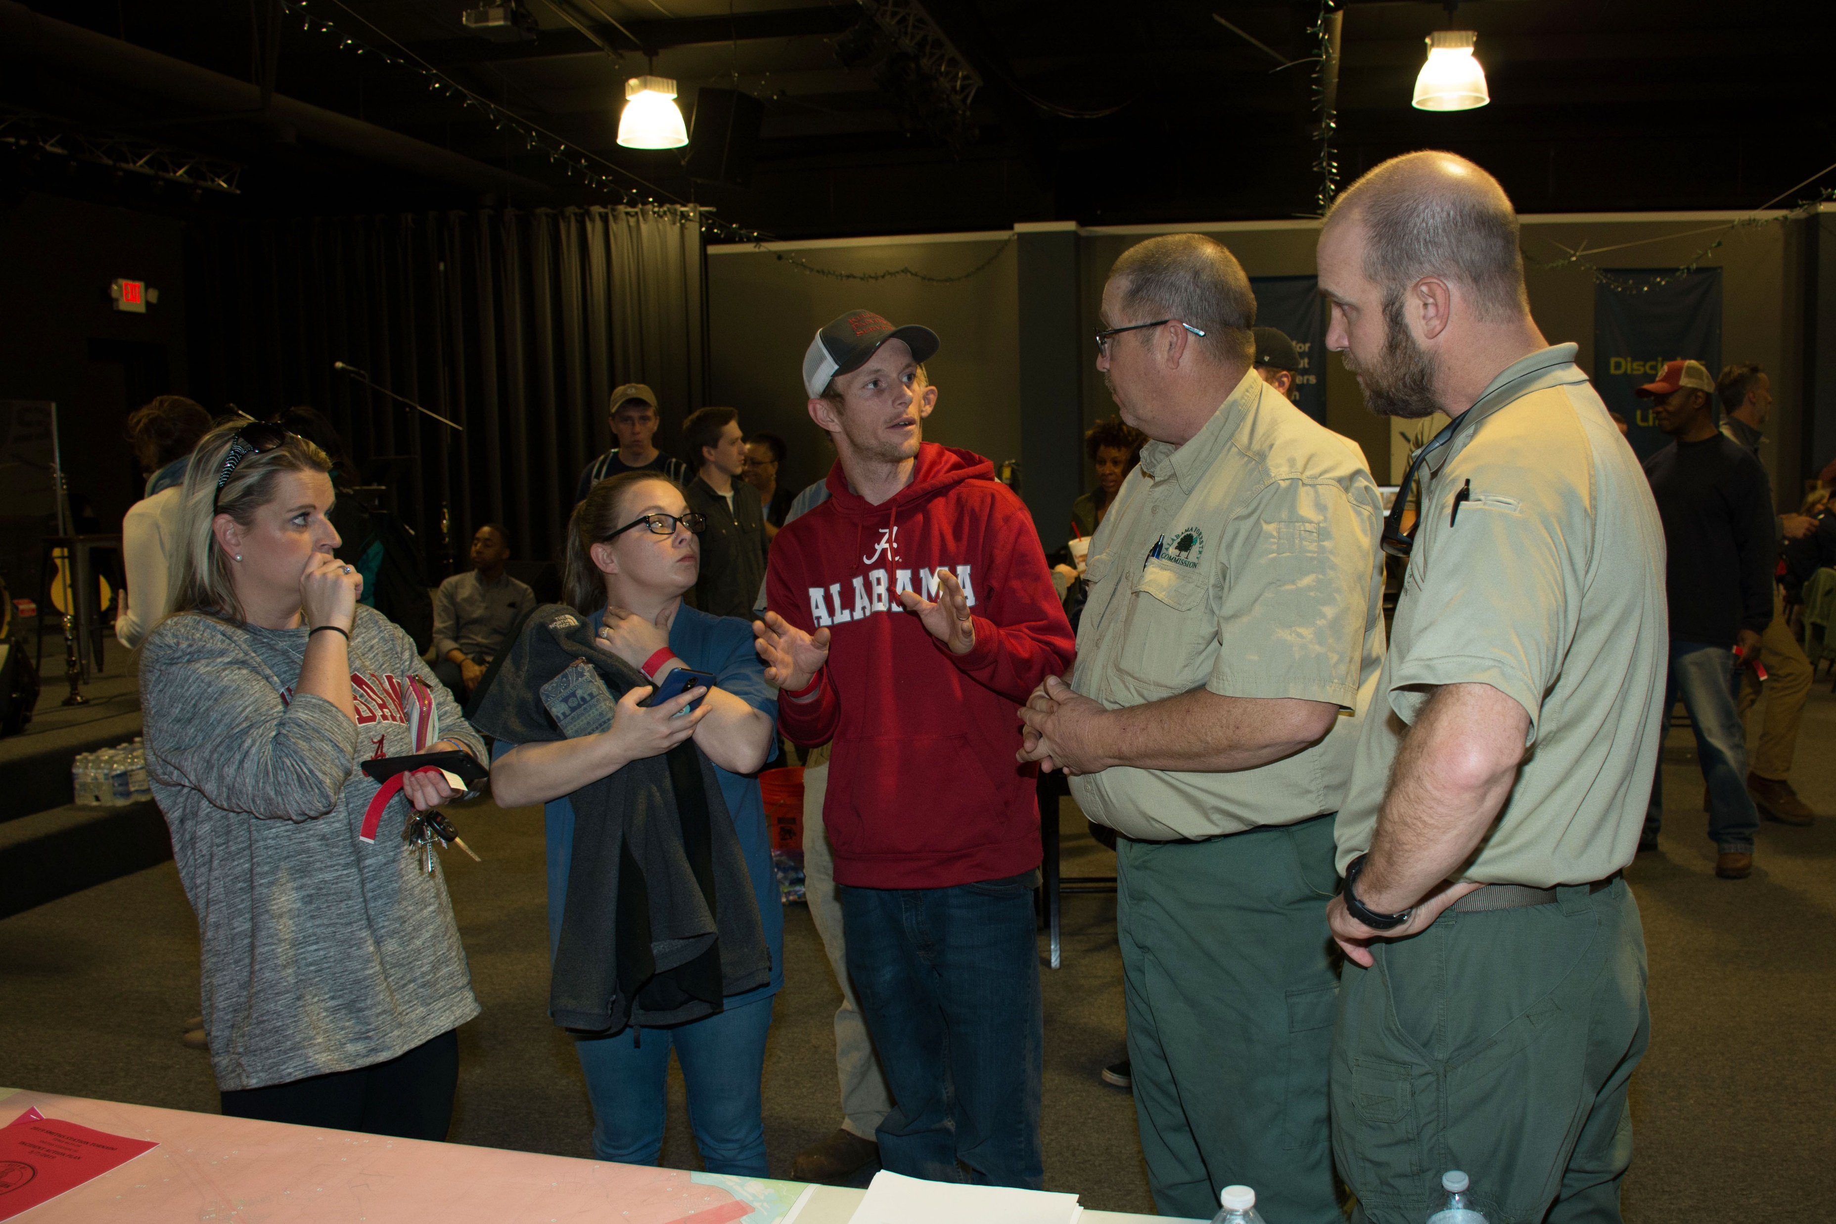
The team’s primary mission was to
assist residents of Lee County to begin returning to as much of a normal life as possible.

Slide 4
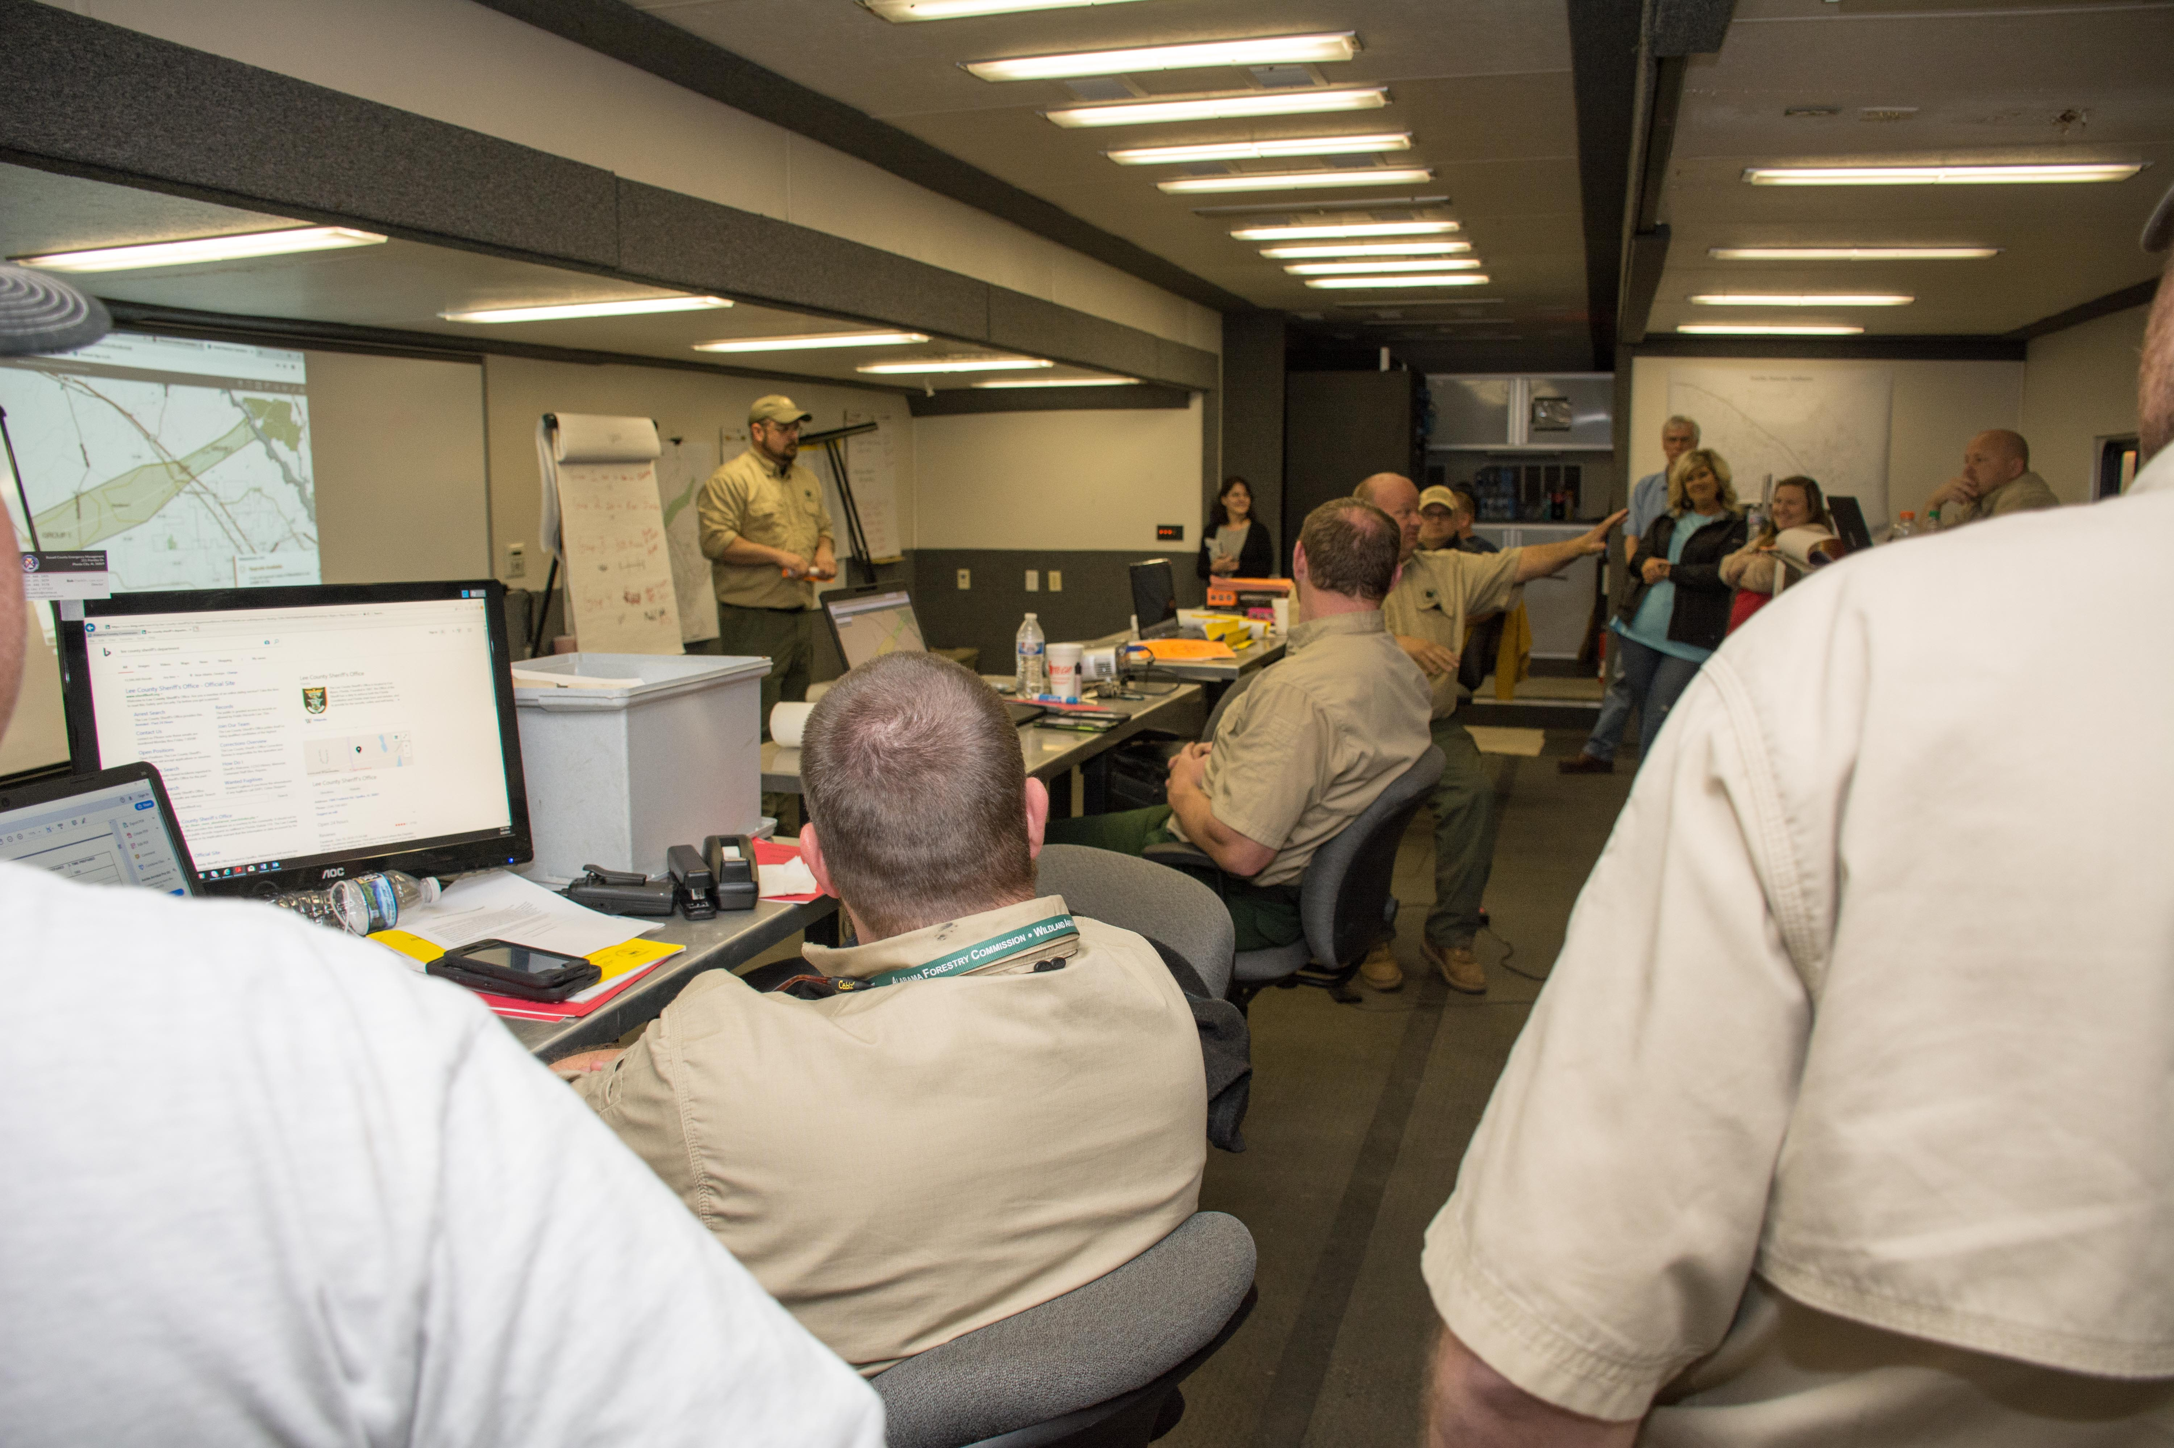
Members of the AFC Incident Management Team, along with Smiths Station personnel met each evening for a briefing to address issues, review the day’s progress, and discuss the next day’s plan of action.

Slide 5
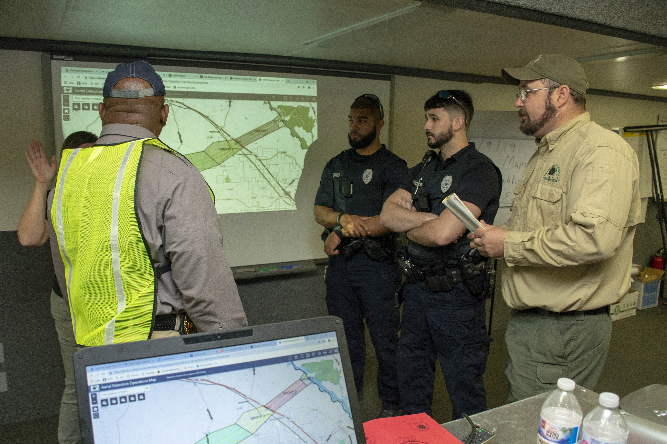
The Incident Management Team also met frequently with local law enforcement and other Smiths Station officials to address concerns in the heavily damaged storm areas.

Slide 6
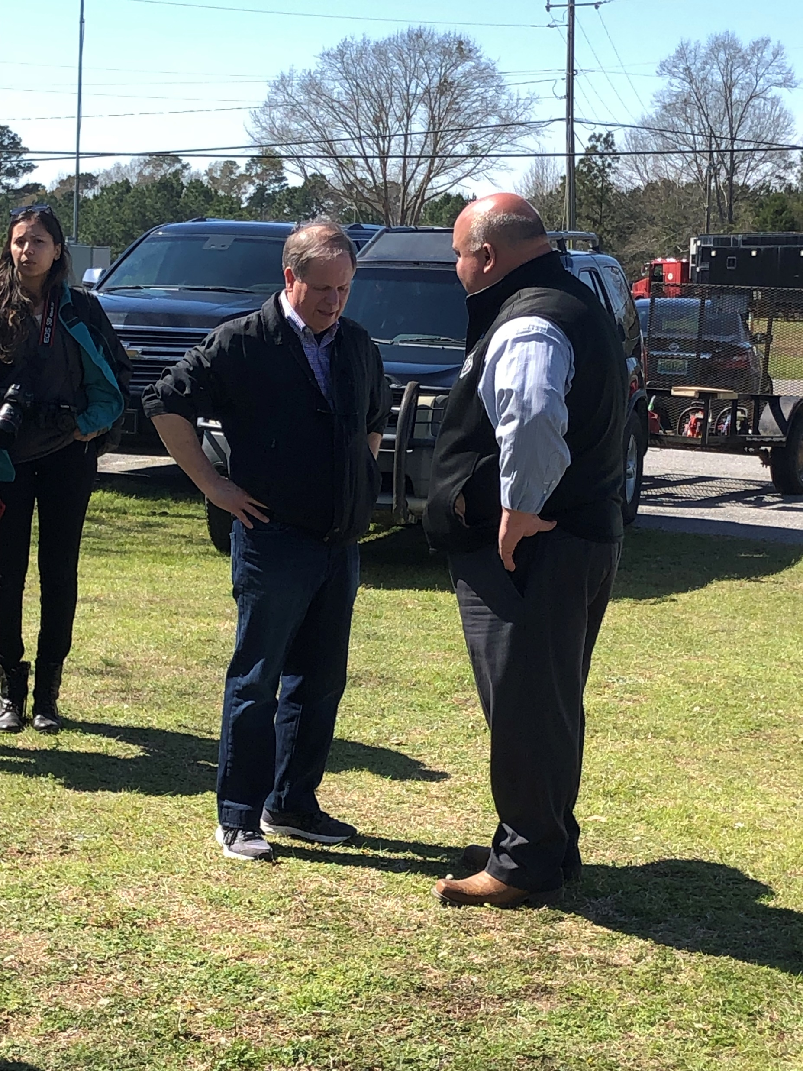
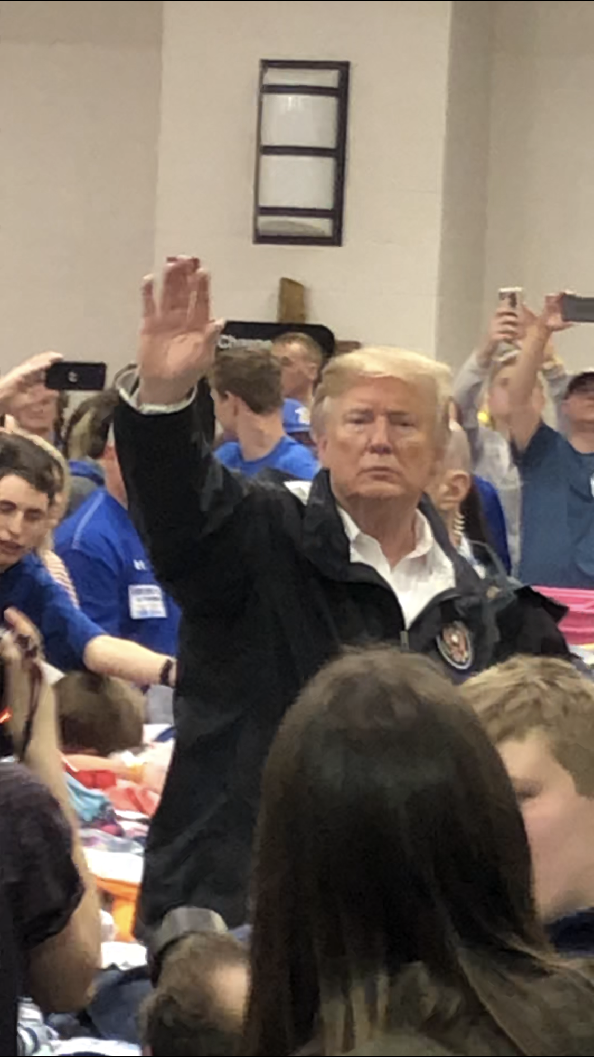
Several dignitaries made visits during the aftermath of the storms. U.S. Senator Doug Jones visited Smiths Station and met with Mayor Copeland on Thursday, March 7. He toured some of the hardest hit areas and visited with volunteers at the Volunteer Resource Center.
U.S. President Donald Trump arrived
on Friday, March 8, to meet with
survivors and family members of
the tornado in the Beauregard and
Smiths Station communities. Along
with the First Lady, he and U.S.
Secretary of Housing & Urban Development Ben Carson, Director of
Homeland Security Kirstjen Nielsen,
U.S. Senator Richard Shelby, Senator
Jones, and Alabama Governor Kay
Ivey toured some of the damaged
areas and also spoke with volunteers
and first responders at the
Volunteer Resource Centers.

Slide 7
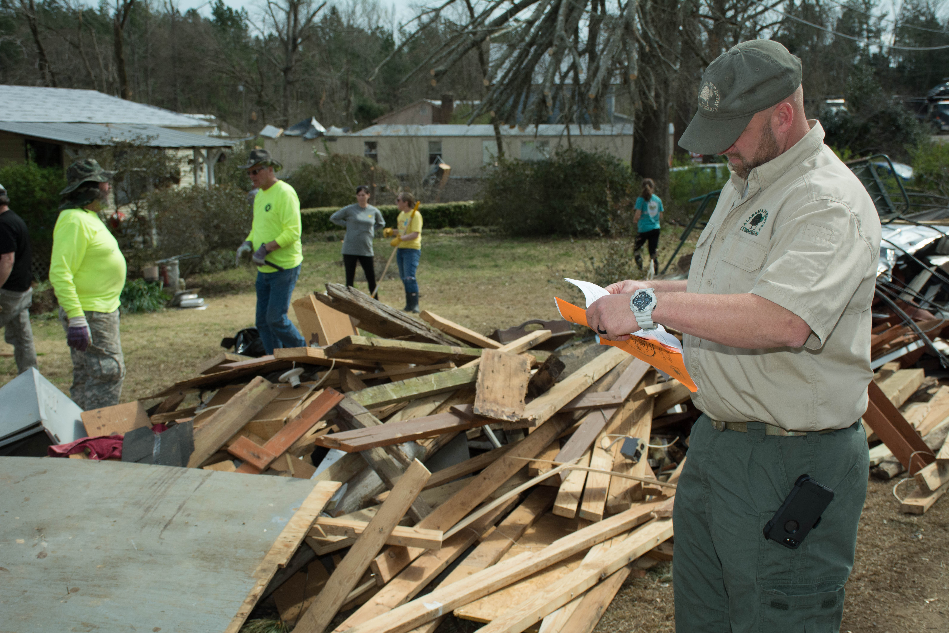
Debris clearing and removal crews in Smiths Station continued to work in their assigned groups. Volunteers worked with members of Alabama Forestry Commission’s Type 3 Incident Management team to provide assistance to area property owners.

Slide 8
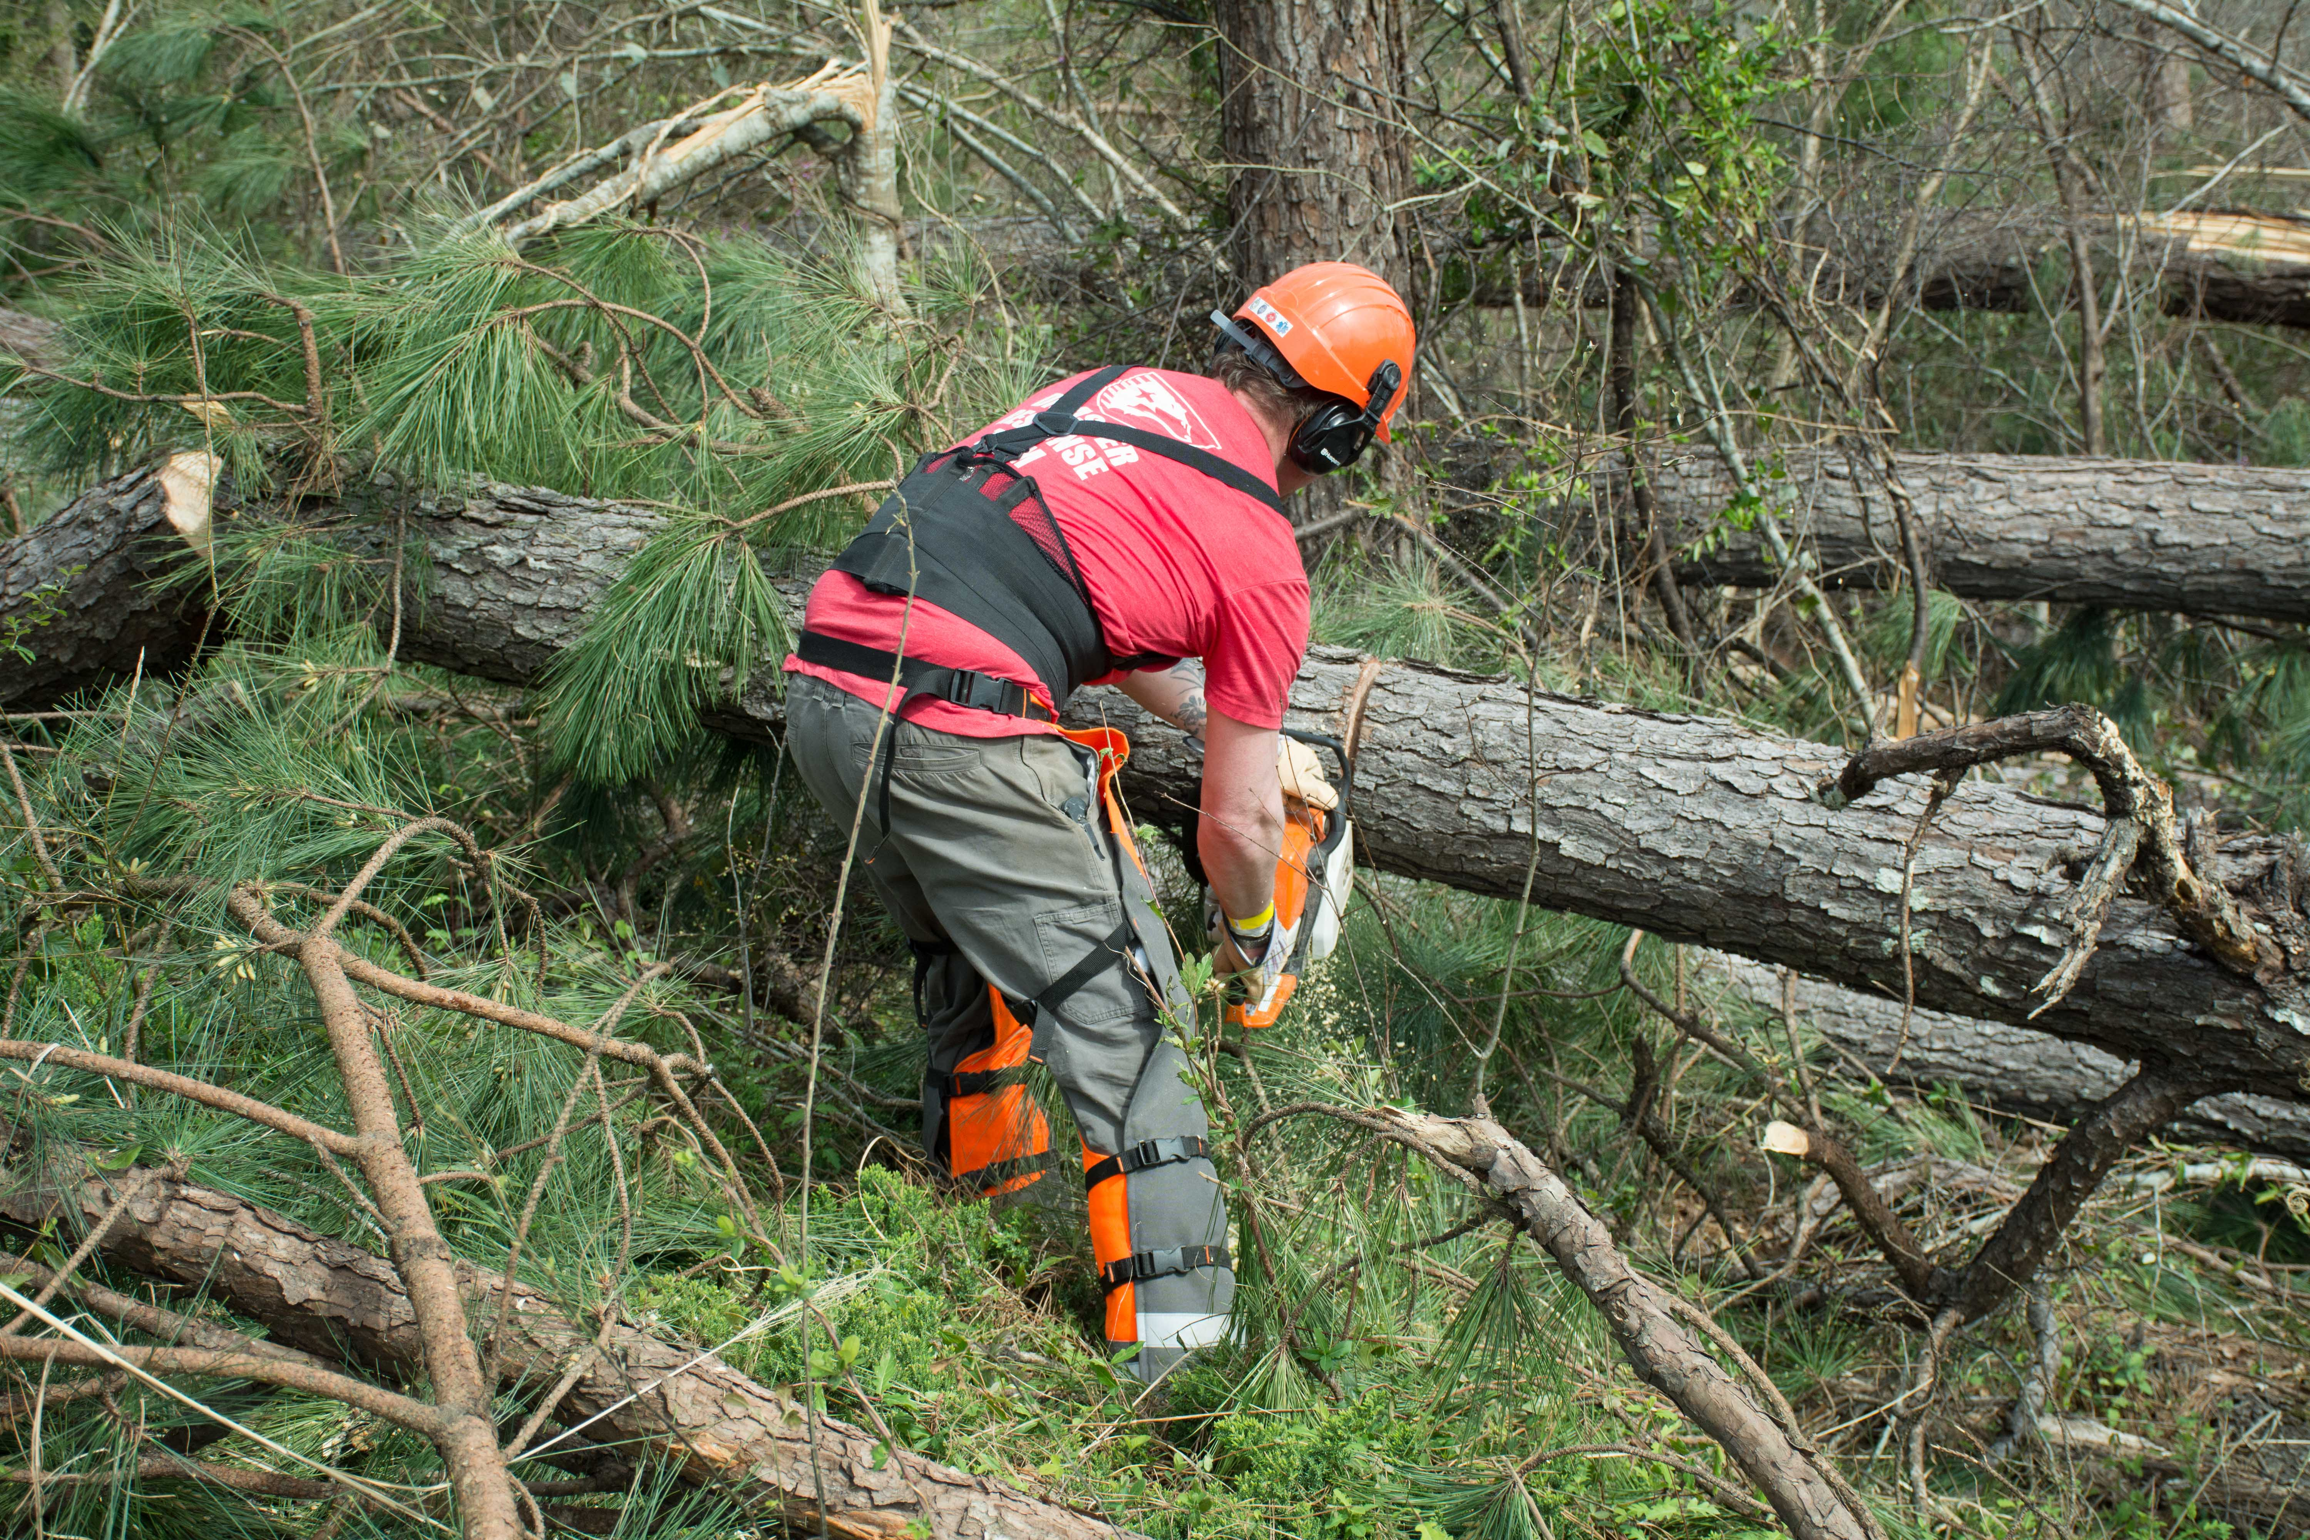
Storm Recovery Continues . . .
On Saturday, an amazing 1,200 volunteers continued to clear and remove tornado debris – using heavy equipment, chain saws, and old fashioned man power – under the direction of the AFC’s Type 3 Incident Management team in Smiths Station. As of March 11, the team had coordinated and assigned tasks to 3,700 volunteers.

Slide 9
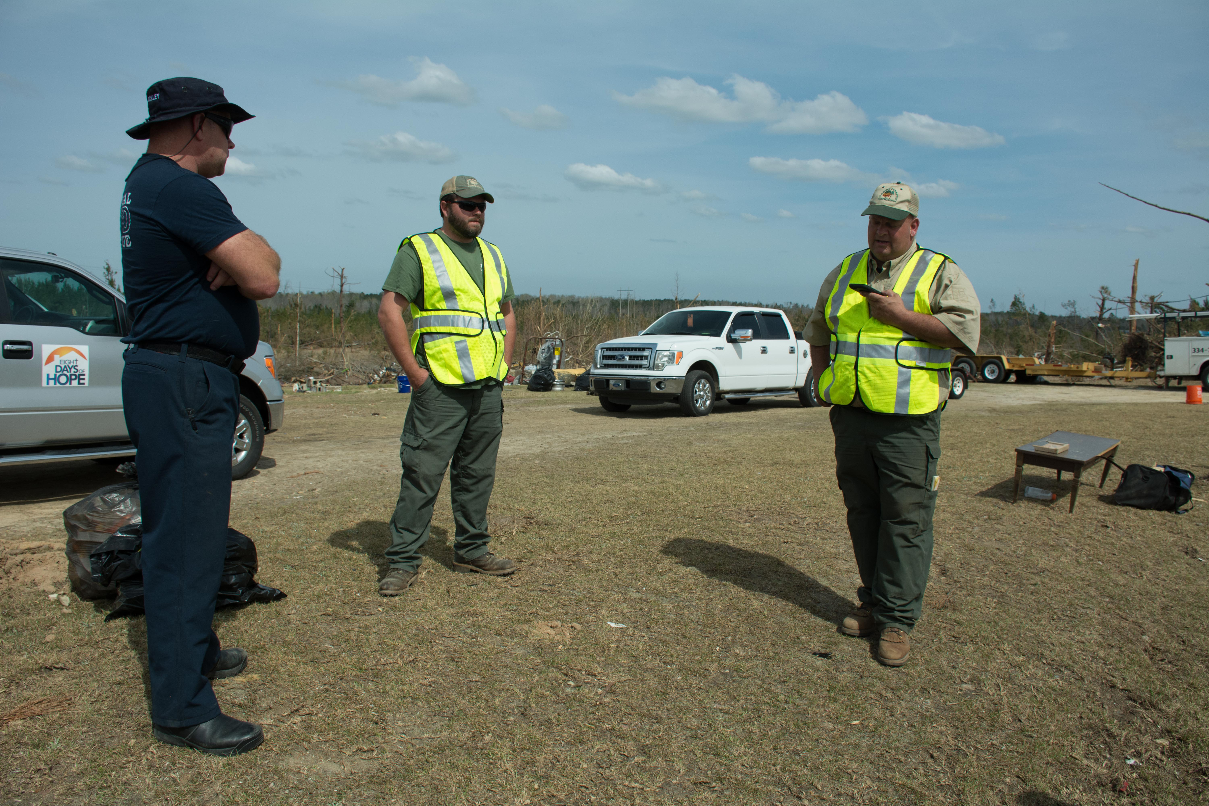
On March 10, AEMA requested that the Incident Management team be extended additional days to also take control and manage Beauregard’s Volunteer Resource Center.

Slide 10
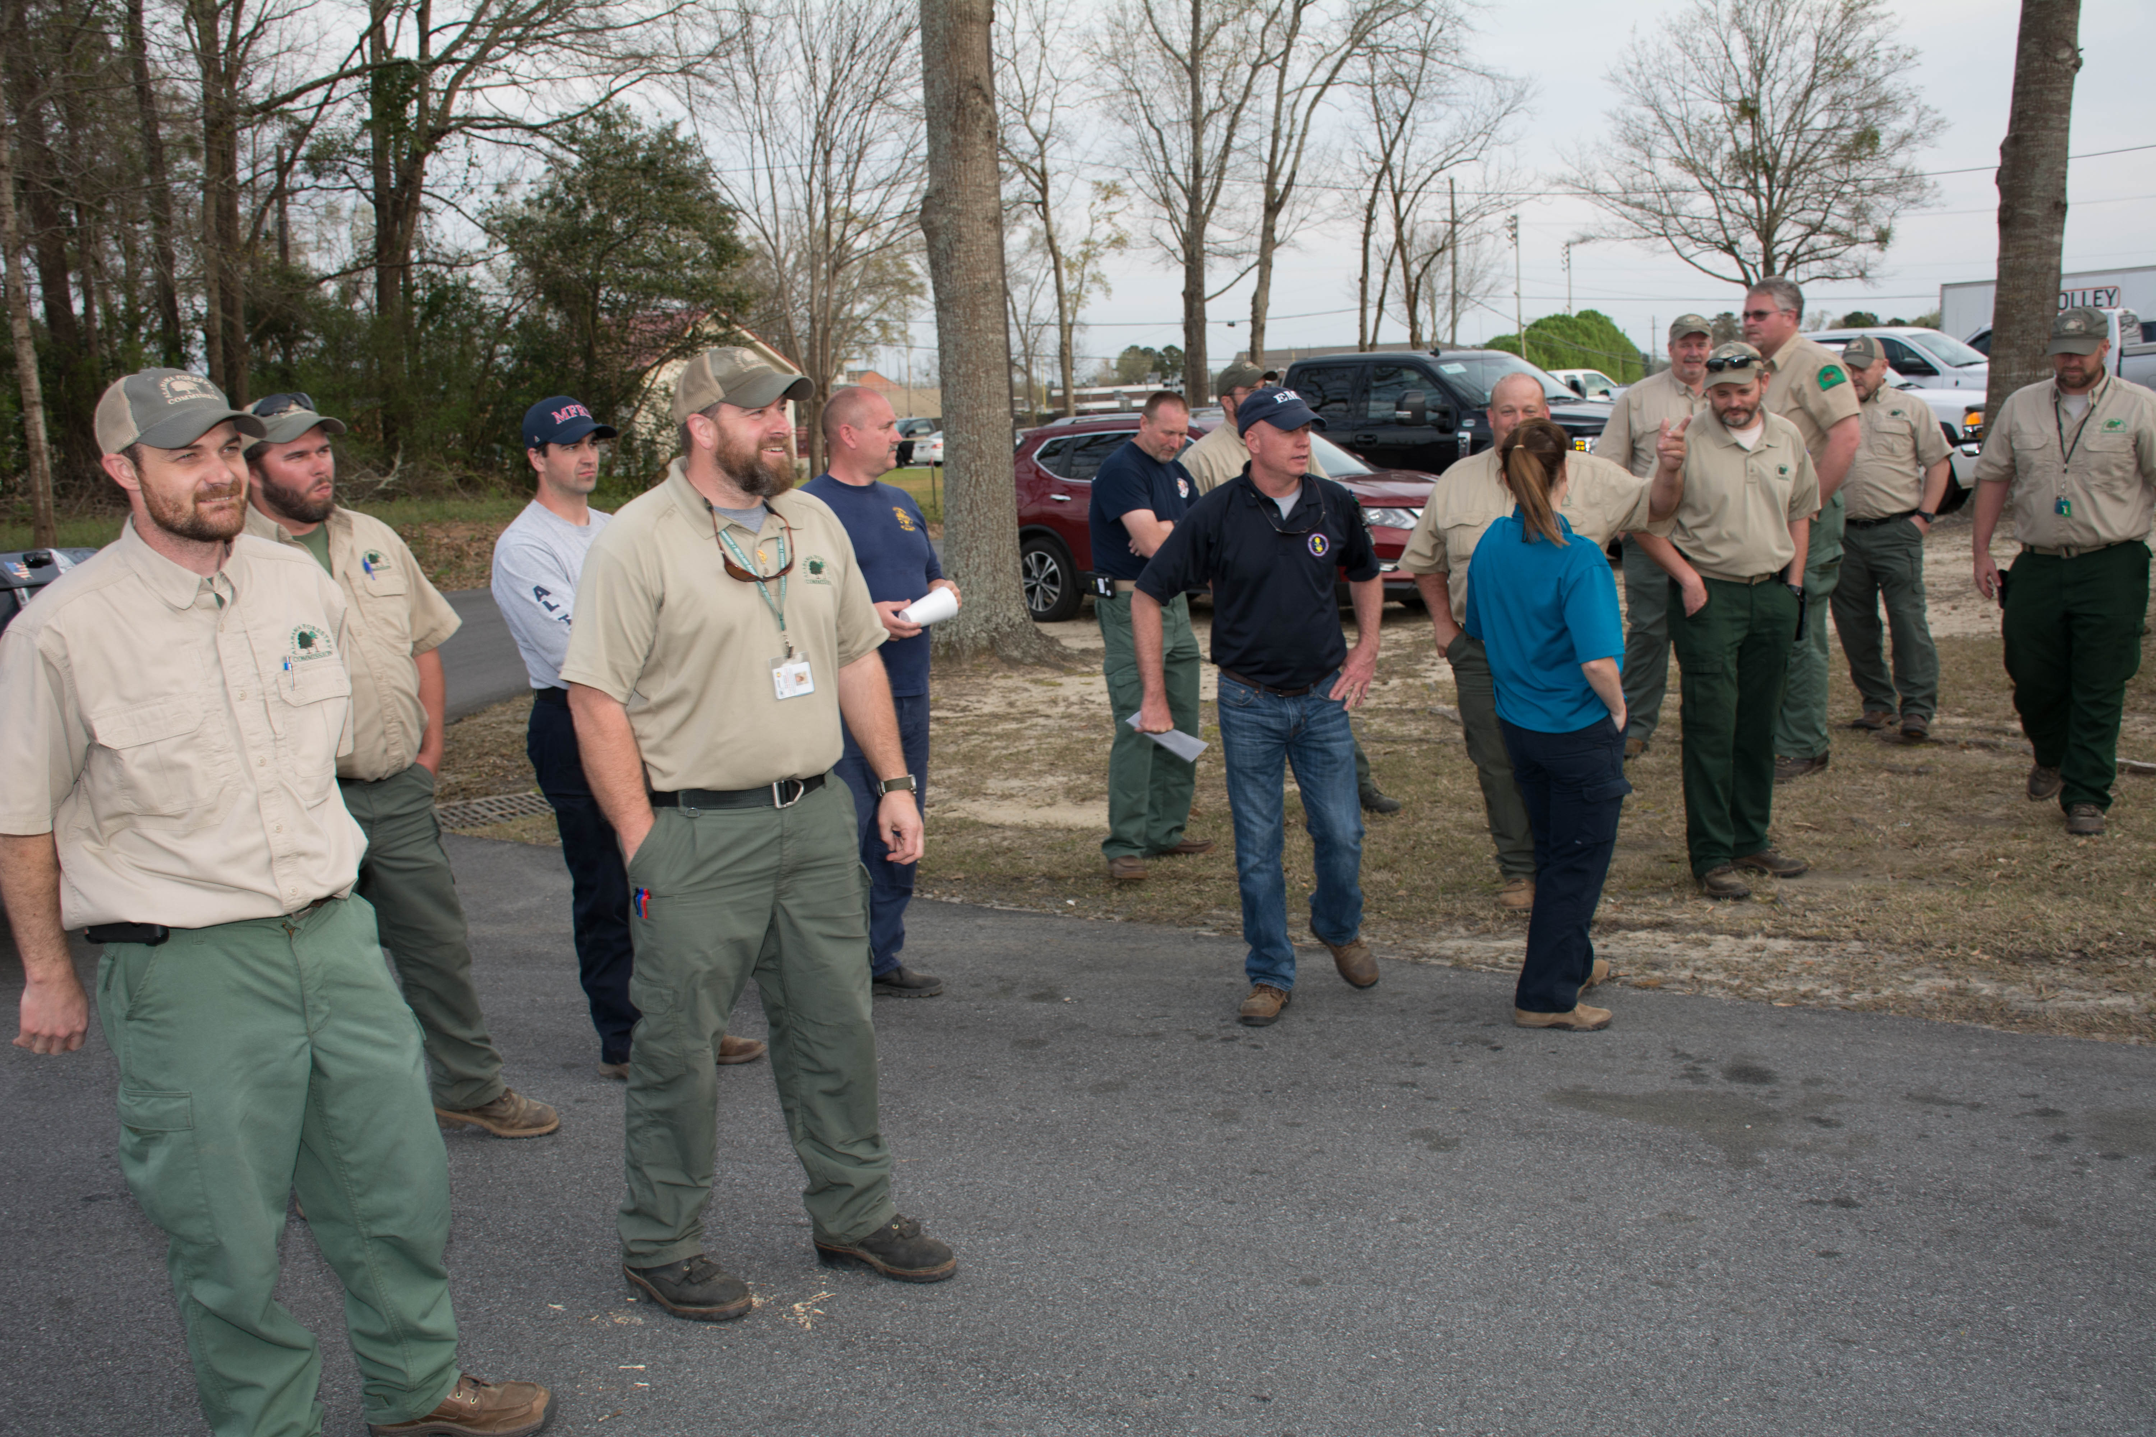
Members of the AFC Type III Incident Management Team attend a candlelight memorial at Smiths Station city hall.

Slide 11
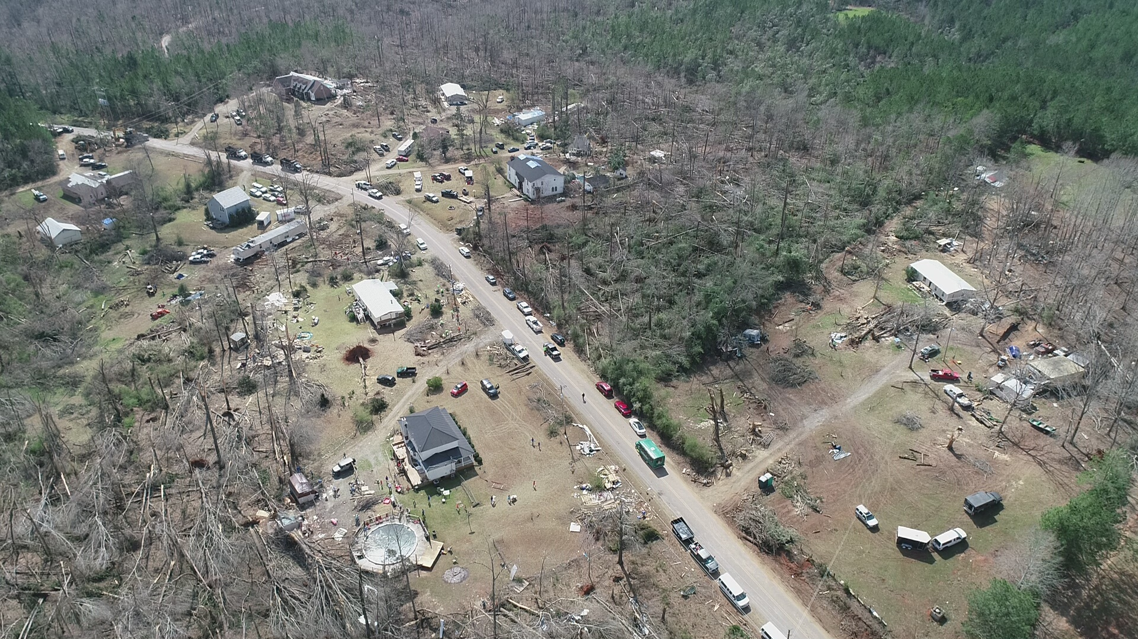
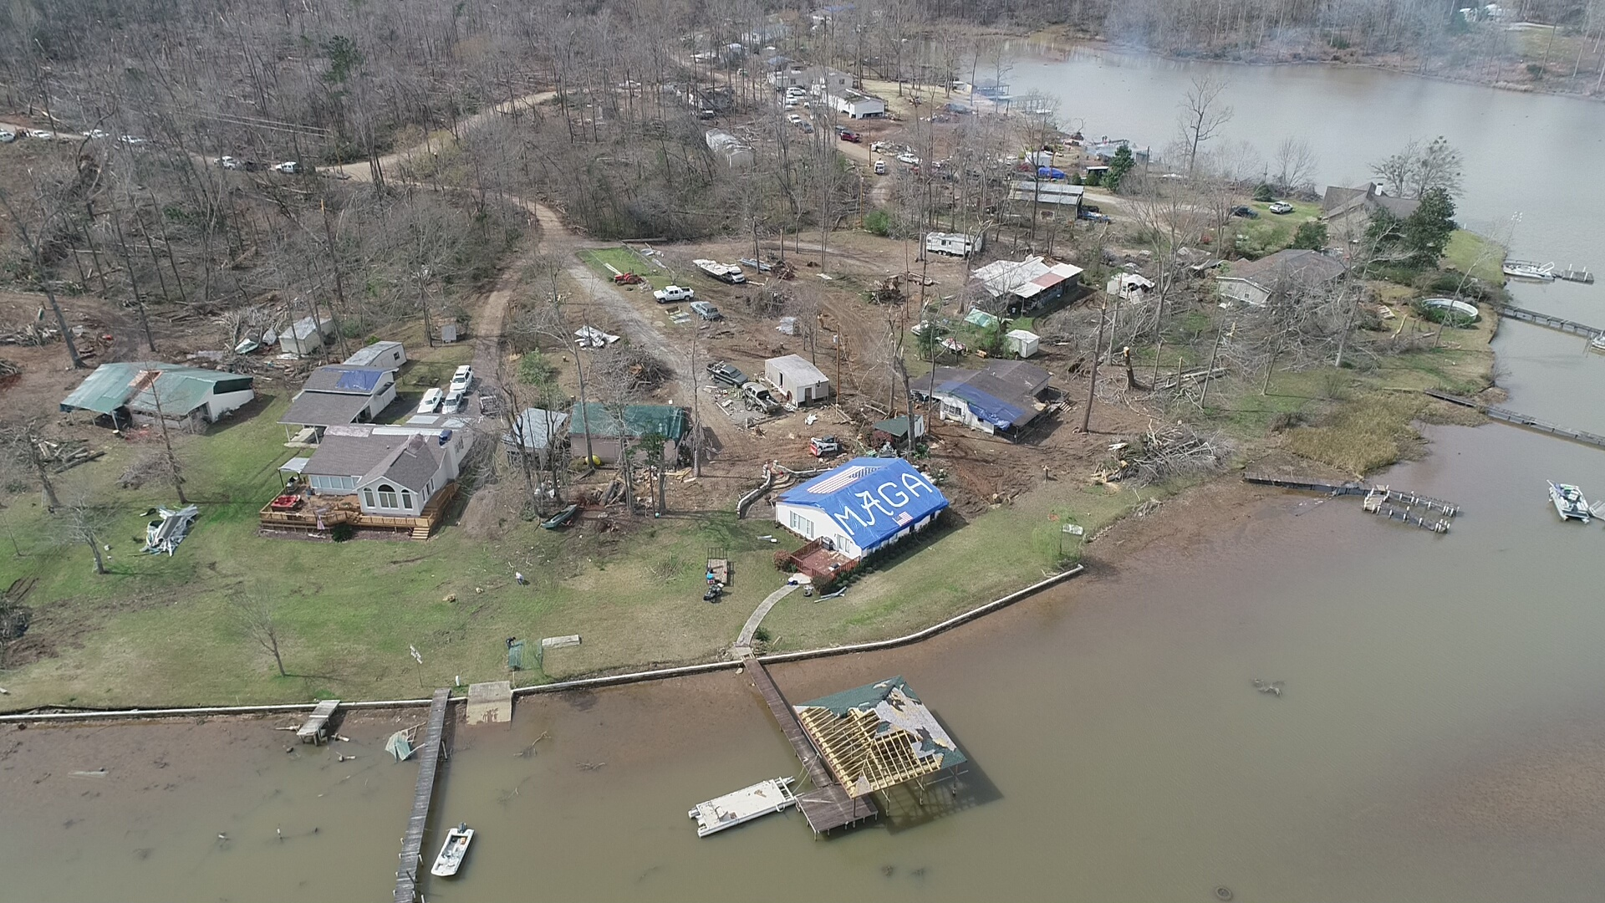
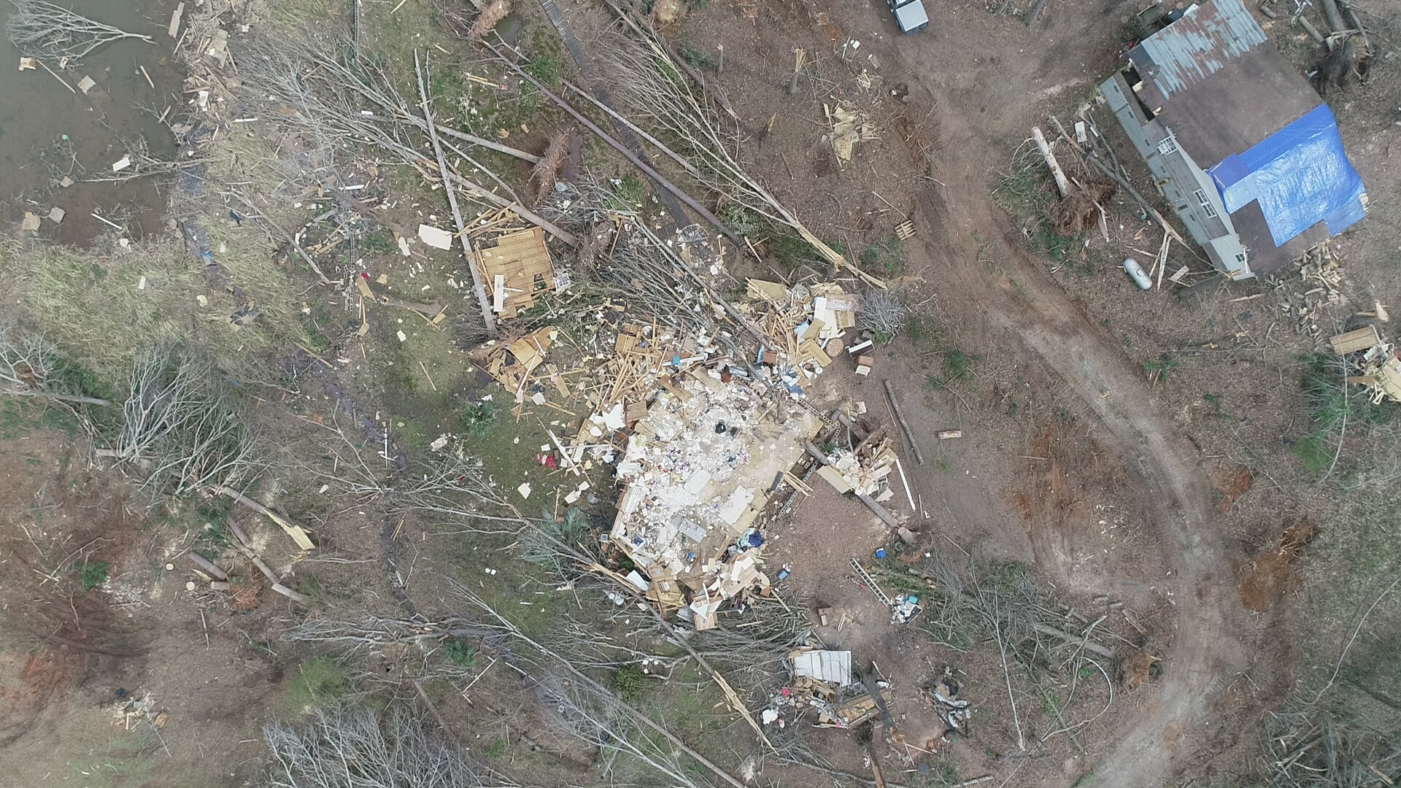
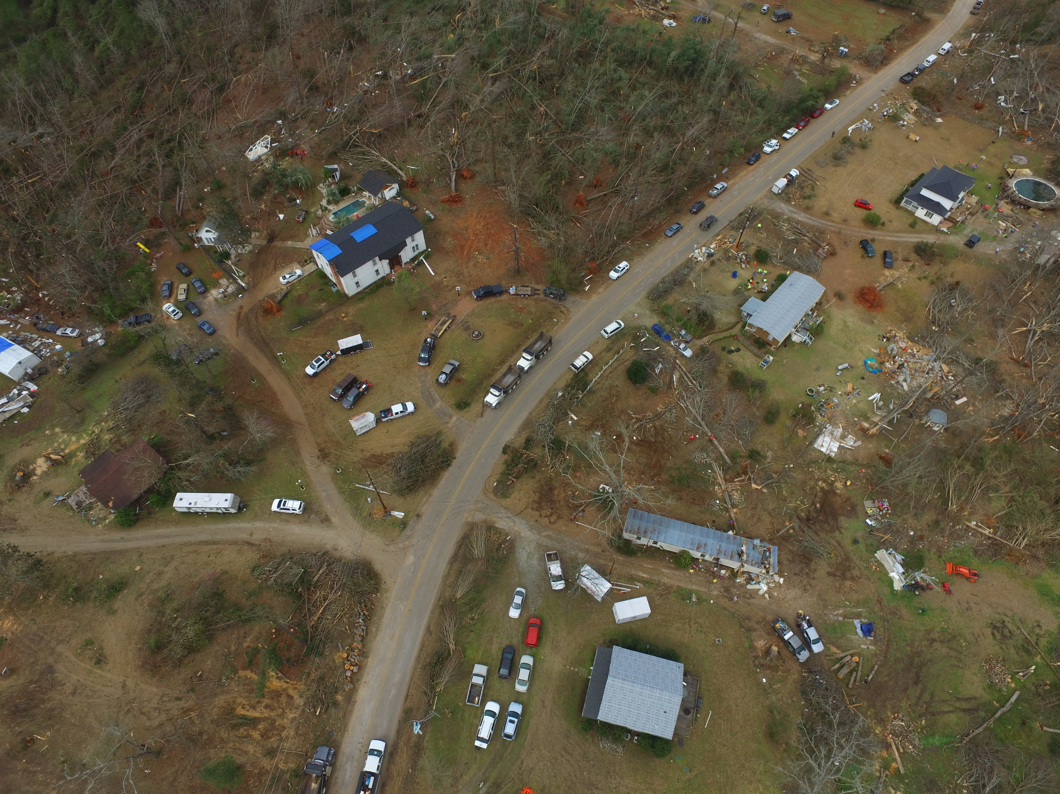
Aerial views of the destruction in Smiths Station

Slide 12
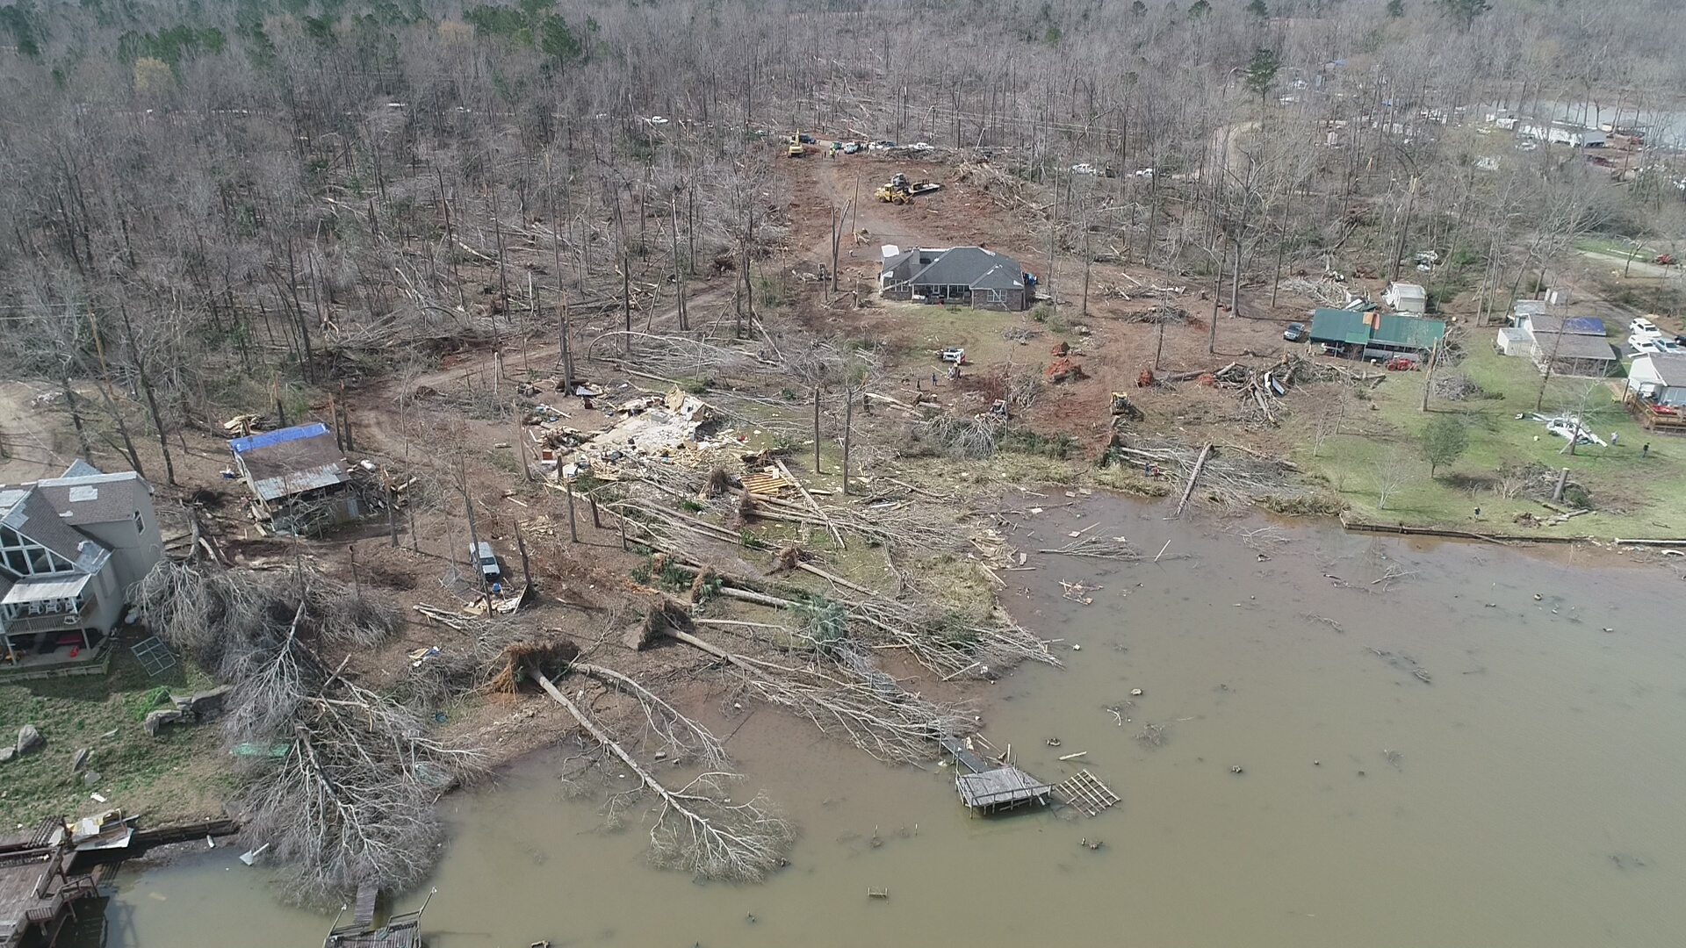
Smith’s Station community

Slide 13
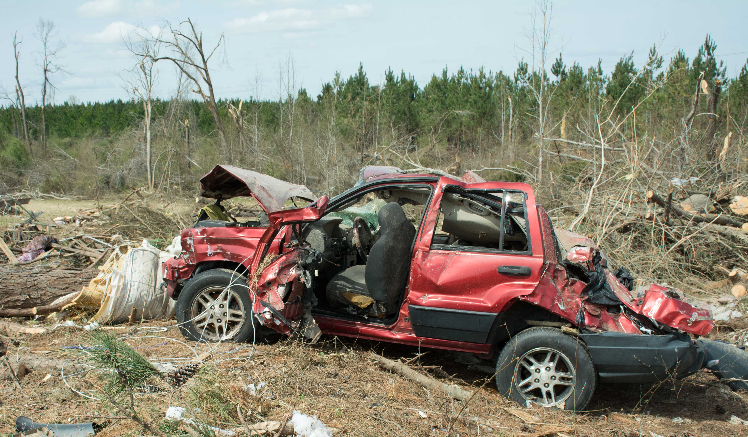
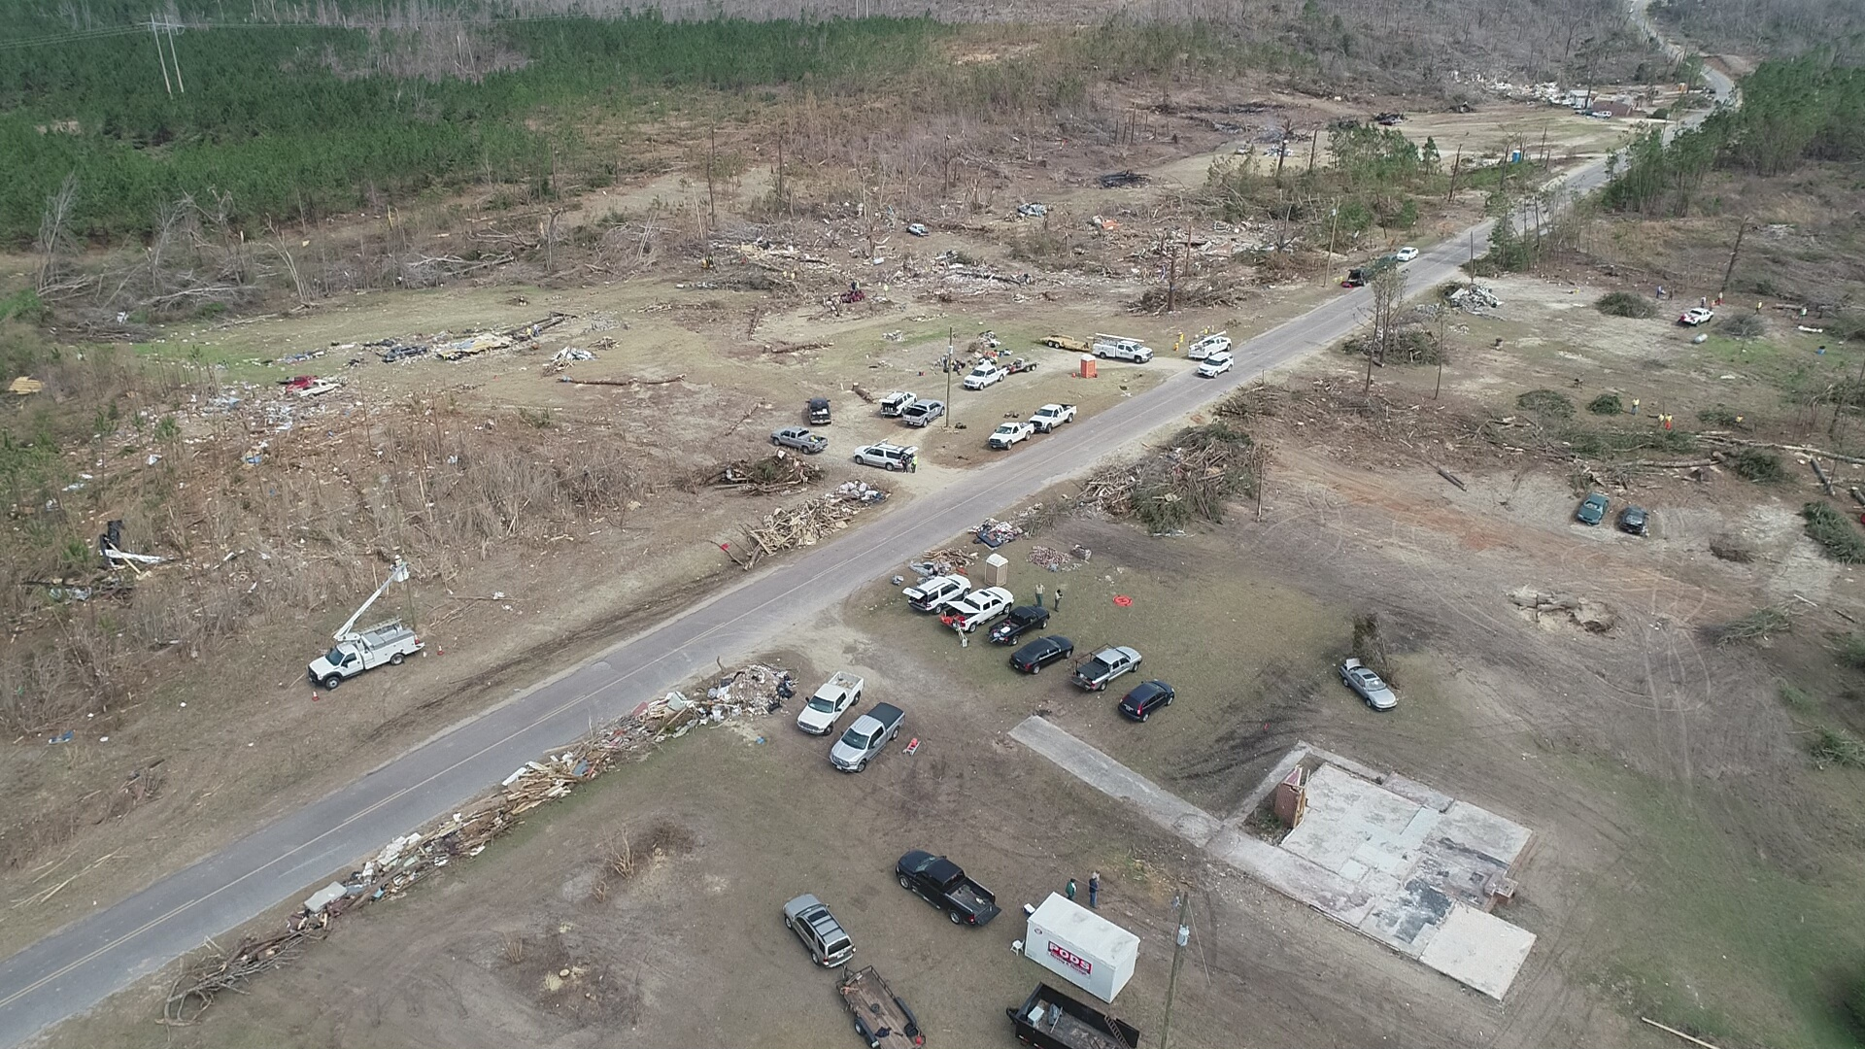
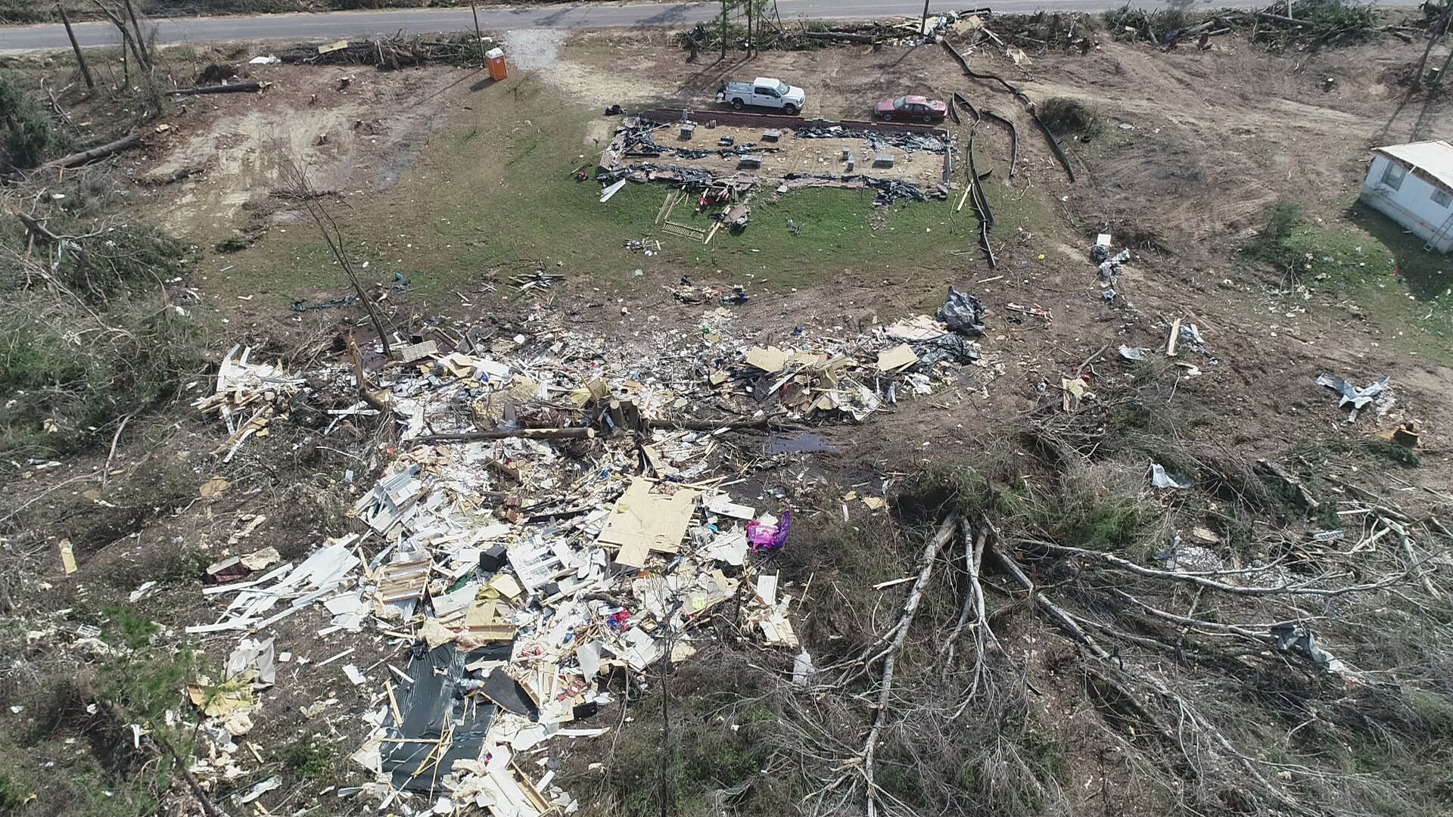
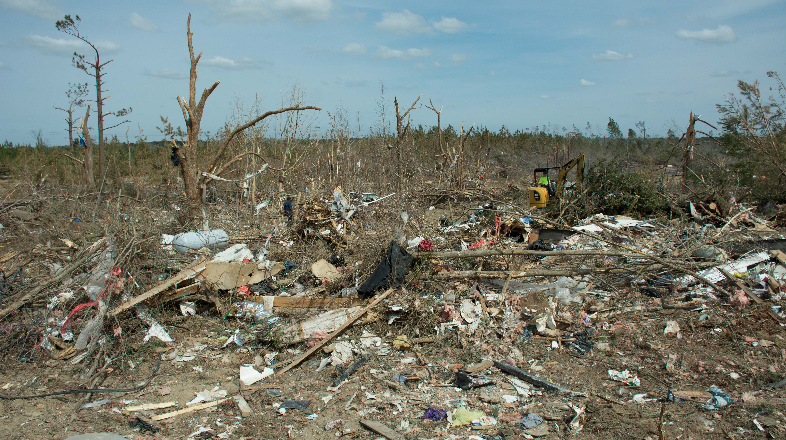
Devastation in the Beauregard community

Slide 14
